Slide 1
Logical Design
Logical design is the entity design without regard to a relational database management system.
One of the principles of relational database is that the logical design should be the same regardless of the DBMS that will be used.
This means you don’t consider the particular limitations or features of a DBMS in the design.

Slide 2
Physical Design
Physical design is the logical design adapted to a particular DBMS.
The design can change slightly to fit into the limitations of a DBMS or to take advantage of DBMS-specific features.

Slide 3
Entity Relation Diagrams
Entity relation diagrams are a common way of diagramming entities, their attributes, and their relationships.
An entity is represented as a rectangle divided into three parts:
The name of the entity
The primary key
The attributes

Slide 4
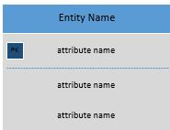
An Entity
Attributes in bold are required

Slide 5
Relationships
A relationship between entities is established by repeating one field, usually the primary key field, from one table in a second table, usually as a foreign key.
The primary key table is sometimes referred to as the “parent” table.
Tables with the foreign keys are referred to as “child” tables.

Slide 6
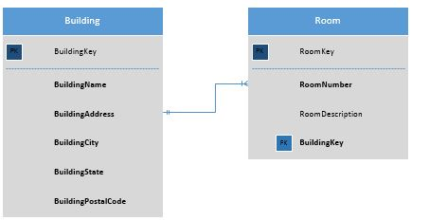
Crows’ Feet Notation for Relationships
The three lines, the crows foot, shows the “many” side of the relationship. The 0 on the building side says a building can have zero or many rooms, the line on the room side says a room must have a building.

Slide 7
Naming Conventions
Naming conventions are crucial for good design.
Ideally you should have a consistent way of naming database objects, such as tables, attributes, keys, and any other database objects, such as stored procedures and triggers.

Slide 8
Book Naming Conventions
Entities and tables are named as single nouns like Tutor, Student, and Session.
Attributes are named with the entity name followed by the attribute name. There are no underscores between. Each new word is capitalized: TutorLastName,
StudentLastName, and so on. This can make for long attribute names, but it makes for maximum clarity.
Primary keys end with the word “Key”: TutorKey, StudentKey, and so on.
Foreign keys retain the name of the primary key.

Slide 9
Term Equivalencies
Logical Design | Physical design | Theoretical
Entity | Table | Relation
Attribute | Column, field | Attribute
 | Row, record | Tuple

Slide 10
Repeating Fields
When creating an entity that can contain many of the same attributes, it is tempting to list or number them.
For example, a tutor can tutor many classes.
The temptation is to create an entity like the following (see next slide):

Slide 11
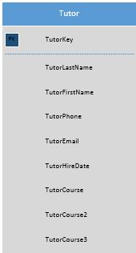
Repeating Attribute Entity

Slide 12
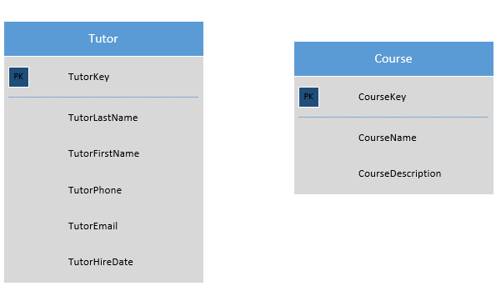
Resolution
Numbering attributes is always a mistake.
It is a sign that you should split the entity into two separate entities

Slide 13
Relationships
There are three types of relationships between entities:
One to one
One to many
Many to many

Slide 14


One to One
A one-to-one relationship means that for every one record in the primary key table, there is no more than one related record in the foreign key table.
Below are the crow’s feet notation for this relationship:
Zero or one
Exactly one

Slide 15
Notes on One-to-One Relationships
One-to-one relationships are rare.
They can be used to rid an entity of null (empty) attributes that inevitably result when contents of an entity have different attributes.
They are sometimes used when data is split between entities for security reasons.

Slide 16
One-to-One Relationship to Prevent Nulls

Slide 17
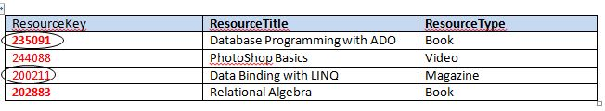


Table Example: One to One For Reducing Nulls

Slide 18
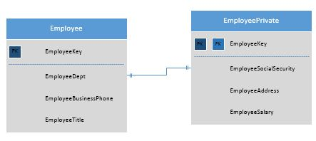
One to One for Security Reasons

Slide 19


One to Many
One to many is the normal relationship between tables.
It means that for every one record in the parent entity, there can be zero to infinity records in the child entity.
Here are the crow’s feet symbols for one to many relationships:
One to zero or many
At least one or many

Slide 20
One to Many Diagram
One Department can contain many Employees

Slide 21
Table Example of One to Many
DepartmentKey | DepartmentName | DepartmentPhone | DepartmentRoom
ACC | Accounting | (206)555-1234 | SB201
IT | Information Technology | (206)555-2468 | NB100
EmployeeKey | EmployeeLastName | EmployeeFirstName | DepartmentKey
FB2001D | Collins | Richard | IT
BN2004N | Faulkner | Leonore | IT
NC2004M | Brown | Carol | ACC
LL2006O | Anderson | Thomas | IT

Slide 22
Caution: Cross Relationship Error
There is a temptation to think that because a department contains many employees, that the relationship should go both ways. Doing this, however, makes it impossible to enter data since before you enter a department, there must be an existing employee in the Employee table, and before you enter an employee, there must be an existing department in the Department table. The result is an unusable stalemate.

Slide 23

Many to Many
A many-to-many relationship means that each record in the primary entity can have many related records in a second entity and each record in the second entity can have many related records in the primary entity.
Many-to-many relationships are legal in logical design, but no DBMS can implement them.

Slide 24
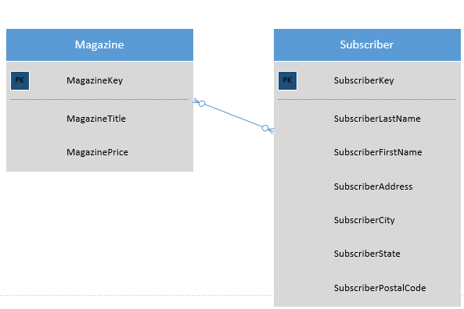
Example of a Many-to-Many Entity Relationship

Slide 25
Resolving Many-to-Many Relationships
Many-to-many relationships must be resolved into two one-to-many relationships.
To do this, it is necessary to create a linking between the two tables that have many-to-many relationships.

Slide 26
Many-to-Many Relationship Resolved

Slide 27
Table View: Magazine and Subscriber
MagazineKey | MagazineName | MagazinePrice
TM2K1 | Time | 35.50
NW2K1 | Newsweek | 36.40
SubscriberKey | Subscriber LastName | Subscriber FirstName | Subscriber Address | Subscriber City | Subscriber State | Subscriber PostalCode
4231 | Johnson | Leslie | 101 Best Ave. | Seattle | WA | 98007
4333 | Anderson | Mark | 1200 Western Blvd. | Tacoma | WA | 98011
5344 | Manning | Tabitha | 100 Westlake | Seattle | WA | 98008

Slide 28
Linking Table: Subscription
SubscriptionKey | MagazineKey | SubscriberKey | SubscriptionStartDate
1004 | TM2K1 | 4333 | 1/15/2009
1005 | NW2K1 | 4333 | 1/15/2009
1006 | NW2K1 | 4231 | 2/1/2009
1007 | TM2K1 | 5344 | 2/15/2009

Slide 29
Cardinality
Cardinality describes the number of permissible relationships between two entities.
Maximum cardinality refers to the maximum number of permitted relationships. (For example, a customer can have no more than 4 listed emails.)
Minimum cardinality refers the minimum number of permitted relationships. (For example, each customer must have at least one purchase in the purchase table.)

Slide 30
Types or Roles of Entities
Entities can take on different roles.
Below is a table of some common roles or types:
Entity Roles | Description
Domain | Entity describing a core business element of the database
Linking | Entity used to resolve a many-to-many relationship into two one-to-many relationships
Lookup | Entity used to store lookup values and help ensure data integrity and consistency
Weak | An entity that depends on another entity for its meaning

Slide 31
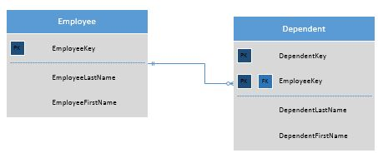
Example of a Weak Entity
An employee can have many dependents, so it is a good design practice to create a separate entity to describe dependents. However, the Dependent entity is a weak entity because it depends on Employee for its meaning.

Slide 32
Documentation
Diagrams often communicate more clearly than words.
It is important to keep all your entity diagrams for documentations along with notations about changes and versions.

Slide 33
Chapter 5
Normalization

Slide 34
Overview
Normalization is the process of removing potential anomalies from the database design.
These anomalies include:
Insertion anomalies
Update anomalies
Deletion anomalies

Slide 35
Insertion Anomalies
An insertion anomaly occurs when you can’t enter a record in because some data is missing.
Consider a database with the rule that every employee must be assigned to a project, but a newly hired employee doesn’t have a project yet.
One solution is to create a dummy project, but this puts bad data into your database and is not a good idea.
Also, setting the course to null is a bad idea, because it puts unknown and meaningless data in the table.

Slide 36
Entity and Table: Insertion Anomaly
EmployeeKey | EmployeeLastName | EmployeeFirstName | ProjectName | ProjectDescription
4123 | Brown | Richard | DB245 | New Employee Database
4124 | Sanderson | Lisa | DB134 | Tune the point of sale database
4215 | Lewis | Wallace | DB245 | New Employee Database

Slide 37
Update Anomalies
Update anomalies occur when the same data is stored in more than one place.
This means whenever you have to make a change to the data, you must do it in several places.
The more times you have to edit the same data in multiple places, the more chances you have of making a mistake, causing inconsistent data.

Slide 38
Deletion Anomalies
Deletion anomalies occur when deleting a record accidently causes other data to be lost.
Look again at the table from the slide about insertion anomalies.

Slide 39
Deletion Anomaly Example
EmployeeKey | EmployeeLastName | EmployeeFirstName | ProjectName | ProjectDescription
4123 | Brown | Richard | DB245 | New Employee Database
4124 | Sanderson | Lisa | DB134 | Tune the point of sale database
4215 | Lewis | Wallace | DB245 | New Employee Database
If Lisa Sanderson were the only person on project DB134, deleting her from the database would also delete the project information.

Slide 40
Normal Forms
Normal forms were developed over the years to address issues of these various anomalies.
The next slide contains a complete list of normal forms.
We will only address the first three directly.

Slide 41
All Normal Forms
First Normal Form
Second Normal Form
Third Normal Form
Boyce Codd Normal Form
Fourth Normal Form
Fifth Normal Form
Domain Key Normal Form

Slide 42
Two Examples
We will use two examples in the discussion of normal forms:
A list of albums
A contact list spreadsheet

Slide 43
Album Example
Album | Tracks | Artist | ArtistCountry
Abby Road | Here Comes the Sun, Octopus Garden, Something, etc. | Beatles | UK
Blond on Blond | Rainy Day Woman, Sad-Eyed Lady of the Lowlands, Stuck in Memphis with the Mobile Blues Again | Bob Dylan | US

Slide 44
Contact List Example 1
LastName/Dept | FirstName | Phone | Building Code | Building | Building Address
Able | Susan | 206.555.2356 | BE | Broadway Edison | 1700 Broadway
Admissions |  | 206.555.1000 | BE | Broadway Edison | 1700 Broadway
Anderson | Elliot | 206.555.1029 | SA | South Annex | 1650 Broadway
Anderson | Jolene | 206.555.9001 | SA | South Annex | 1650 Broadway
Bradley | Lisa | 206.555.2323 | BE | Broadway Edison | 1700 Broadway
Brown | Martin | 206.555.1200 | SA | South Annex | 1650 Broadway
Information Technology |  | 206.555.1200 | SA | South Annex | 1650 Broadway

Slide 45
Contact List Example 1 Cont.
Office | Dept | Type | Status | Title | Email
314 | HUM | Instruction | FT | Professor | sable@university.edu
124 | ADM
212 | IT | Instruction | PT | Professor | eanderson@university.edu
113 | IT | Instruction | PT | Professor | janderson@university.edu
114 | MAT | Staff | FT | Program Assistant, Lab Assistant | lbradely@university.edu
201 | IT | Exempt |  | Dean IT | mbrown@university.edu

Slide 46
First Normal Form (1NF)
The first normal form involves getting rid of all repeating groups and arrays.
Repeating groups can be lists of values separated by commas.
They can also be enumerated fields, such as phone1, phone2, etc.
Also, to meet NF1, every column should contain only one type of data.

Slide 47
Album List 1NF
The tracks field in the album table is multivalued. It contains a list of the tracks associated with the album.
This violates NF1.
It is tempting to try to create a series of fields like Track1, Track2. . .Track13.
This also violates NF1 and is a bad idea for several reasons:
What if there were 14 tracks
What if there are only 4
To find any 1 track, you would have to query 13 fields

Slide 48
Temporary Solution Albums 1NF
AlbumTitle | Track | Artist | ArtistCountry
Abby Road | Here Comes the Sun | Beatles | UK
Abby Road | Octopus’s Garden | Beatles | UK
Abby Road | Something | Beatles | UK
Blond on Blond | Rainy Day Woman | Bob Dylan | US
Blond on Blond | Sad-Eyed Lady of the Lowlands | Bob Dylan | US
Blond on Blond | Stuck in Mobile with the Memphis Blues Again | Bob Dylan | US
The tracks are no longer listed. Each is separated into individual rows. Each row is unique. Still, there is a lot of redundancy.

Slide 49
Contact List Example 1NF
The contact spreadsheet has several problems:
The LastName/Dept column stores two different types of values: employee names and department names.
Also, some employees such as Lisa Bradley have more than one title.

Slide 50
Contact List Solution
The solution is to separate the Department and LastName into different columns.
The title we will break out into a separate entity and then create a linking entity.
To do that we will need to provide primary keys. We will use a surrogate key for this example.

Slide 51
Contact List Tables (1NF)
ContactKey | LastName | FirstName | DeptName | Phone | Building Code
1 | Able | Susan |  | 206.555.2356 | BE
2 | Admissions |  | Admissions | 206.555.1000 | BE
3 | Anderson | Elliot |  | 206.555.1029 | SA
4 | Anderson | Jolene |  | 206.555.9001 | SA
5 | Bradley | Lisa |  | 206.555.2323 | BE
6 | Brown | Martin |  | 206.555.1200 | SA
7 |  |  | Information Technology | 206.555.1200 | SA

Slide 52
Contact List Tables (1NF) Cont.
Building | Building Address | Office | Dept | Type | Status | Email
Broadway Edison | 1700 Broadway | 314 | HUM | Instruction | FT | sable@university.edu
Broadway Edison | 1700 Broadway | 124 | ADM
South Annex | 1650 Broadway | 212 | IT | Instruction | PT | eanderson@university.edu
South Annex | 1650 Broadway | 113 | IT | Instruction | PT | janderson@university.edu
Broadway Edison | 1700 Broadway | 114 | MAT | Staff | FT | lbradely@university.edu
South Annex | 1650 Broadway | 201 | IT | Exempt |  | mbrown@university.edu
South Annex | 1650 Broadway | 200

Slide 53
Title and Contact Title Tables
TitleKey | TitleName
1 | Professor
2 | Program Assistant
3 | Dean
4 | Lab Assistant
ContactKey | TitleKey
1 | 1
3 | 1
4 | 1
5 | 2
5 | 4
6 | 3

Slide 54
Contact List ERD 1NF

Slide 55
Second Normal Form (2NF)
Second Normal Form removes what are called “functional dependencies.”
Functional dependencies are groups of columns that depend on each other rather than on the key of the table.
One way to look at functional dependencies is to look at them as themes or subthemes in the data.

Slide 56
Album Example 2NF
In the Album table, Tracks represent a separate theme or functional dependency.
TrackTitle, Artist, and ArtistCountry group together separate from the Album.
Artist goes with Track because many albums contain tracks by multiple artists.
We add primary keys to the Album and Track tables.

Slide 57
Album and Track Tables (2NF)
AlbumKey | AlbumTitle
ABRD | Abby Road
BLBL | Blond On Blond
TrackKey | TrackTitle | AlbumKey | Artist | ArtistCountry
HCTS | Here Comes the Sun | ABRD | Beatles | UK
SMTH | Something | ABRD | Beatles | UK
OPGD | Octopus’s Garden | ABRD | Beatles | UK
RDWM | Rainy Day Woman | BLBL | Bob Dylan | Us
SELL | Sad-Eyed Lady of the Lowlands | BLBL | Bob Dylan | US
SMMB | Stuck in Memphis with the Mobile Blues | BLBL | Bob Dylan | US

Slide 58
Album Track ERD (2NF)

Slide 59
Contact List (2NF)
In the contact list there are two distinct types of contacts: employees and departments.
BuildingCode, BuildingName, and BuildingAddress also constitute a functional dependency.
The solution is to break both departments and buildings into separate entities.

Slide 60
Building and Employee Tables 2NF
BuildingKey | BuildingCode | BuildingName | BuildingAddress
1 | BE | Broadway Edison | 1700 Broadway
1 | SA | South Annex | 1650 Broadway
EmployeeKey | LastName | FirstName | Phone | Building Code
1 | Able | Susan | 206.555.2356 | 1
2 | Anderson | Elliot | 206.555.1029 | 2
3 | Anderson | Jolene | 206.555.9001 | 2
4 | Bradley | Lisa | 206.555.2323 | 1
5 | Brown | Martin | 206.555.1200 | 2
Office | DeptKey | Type | Status | Email
314 | 1 | Instruction | FT | sable@university.edu
212 | 2 | Instruction | PT | eanderson@university.edu
113 | 2 | Instruction | PT | janderson@university.edu
114 | 3 | Staff | FT | lbradely@university.edu
201 | 2 | Exempt |  | mbrown@university.edu

Slide 61
Department Table 2NF
DeptKey |  | DeptAbrv | DeptName | DeptPhone | Building Code | Office
 | 1 | Hum | Humanities | 206.555.1300 | 1 | 301
 | 2 | IT | Information Technology | 206.555.1200 | 2 | 200
 | 3 | MAT | Math | 206.555.1400 | 1 | 245
 | 4 | ADM | Admissions | 206.555.1000 | 1 | 124

Slide 62
Contact List ERD 2NF

Slide 63
Third Normal Form 3NF
Third Normal Form removes more subtle dependencies called “Transient dependencies.”
Transient dependencies are where a field depends more on another column for its meaning than on the Table key.

Slide 64
Album Example 3NF
In the Album example, ArtistCountry is a transient dependency.
It depends on ArtistName more than on the TrackKey.
The solution is to break ArtistName and its dependent column ArtistCountry into its own entity.

Slide 65
Album Tables 3NF
AlbumKey | AlbumTitle
ABRD | Abby Road
BLBL | Blond On Blond
ArtistKey | ArtistName | ArtistCountry
BTLS | Beatles | UK
BDLN | Bob Dylan | US
TrackKey | TrackTitle | AlbumKey | ArtistKey
HCTS | Here Comes the Sun | ABRD | BTLS
SMTH | Something | ABRD | BTLS
OPGD | Octopus’s Garden | ABRD | BTLS
RDWM | Rainy Day Woman | BLBL | BDLN
SELL | Sad-Eyed Lady of the Lowlands | BLBL | BDLN
SMMB | Stuck in Memphis with the Mobile Blues | BLBL | BDLN

Slide 66
Album ERD 3NF

Slide 67
Contact List 3NF
In the contact list example, three transitive dependencies exist.
For one in the Employee table, the DeptName depends on DeptKey rather than on the EmployeeKey.
Also, in the Employee table, the Room column depends on the Building Code.
The same dependency exists in the Department table.
The solution is to remove the DeptName attribute from Employee and create a new entity called BuildingRoom.

Slide 68
Employee Table 2NF
EmployeeKey | LastName | FirstName | Phone | BuildingRoomKey
1 | Able | Susan | 206.555.2356 | 5
2 | Anderson | Elliot | 206.555.1029 | 9
3 | Anderson | Jolene | 206.555.9001 | 6
4 | Bradley | Lisa | 206.555.2323 | 1
5 | Brown | Martin | 206.555.1200 | 8
DeptKey | Type | Status | Email
1 | Instruction | FT | sable@university.edu
2 | Instruction | PT | eanderson@university.edu
2 | Instruction | PT | janderson@university.edu
3 | Staff | FT | lbradely@university.edu
2 | Exempt |  | mbrown@university.edu

Slide 69
Department, EmployeeTitle, and Title Tables 2NF
DeptKey | DeptAbrv | DeptName | DeptPhone | BuildingRoomKey
1 | Hum | Humanities | 206.555.1300 | 4
2 | IT | Information Technology | 206.555.1200 | 7
3 | MAT | Math | 206.555.1400 | 3
4 | ADM | Admissions | 206.555.1000 | 2
EmployeeKey | TitleKey
1 | 1
2 | 1
3 | 1
4 | 2
4 | 4
5 | 3
TitleKey | TitleName
1 | Professor
2 | Program Assistant
3 | Dean
4 | Lab Assistant

Slide 70
Building and BuildingRoom Tables 2NF
BuildingKey | BuildingCode | BuildingName | BuildingAddress
1 | BE | Broadway Edison | 1700 Broadway
1 | SA | South Annex | 1650 Broadway
BuildingRoomKEY | BuildingKey | Room
1 | 1 | 114
2 | 1 | 124
3 | 1 | 245
4 | 1 | 301
5 | 1 | 314
6 | 2 | 113
7 | 2 | 200
8 | 2 | 201
9 | 2 | 212

Slide 71
Contact List ERD 3NF

Slide 72
Denormalization
Sometimes it is necessary to denormalize a table for performance reasons.
Denormalization is where you recombine tables that were split apart to conform to the rules of the various normal forms.
Denormalization should never be done lightly, because it opens up your database to the anomalies and errors normalization was designed to eliminate.

Slide 73
Documentation
You should keep every version of your ERDs as you work your way through the design and normalization process.
Each ERD should contain notations about all changes and the reasons for making them.

Slide 74
Chapter 6
Physical Design

Slide 75
Physical Design
As mentioned in Chapter 4, physical design is the process of adapting the logical design of the database to the actual DBMS.
The logical design can be adapted to meet the limitations and features of the chosen DBMS.

Slide 76
Choosing a DBMS
Many times you won’t have a choice of a DBMS; you will simply work with the one that is installed for your business.
But sometimes you may have to choose which DBMS to use.
When choosing a DBMS there are several things to consider.

Slide 77
Things to Consider When Choosing a DBMS
Compatibility with existing networks and systems
Hardware and software requirements for the DBMS
Features of the DBMS in relation to the data requirements
Familiarity and expertise in the DBMS by IT staff
Price and licensing
Product reliability and support

Slide 78
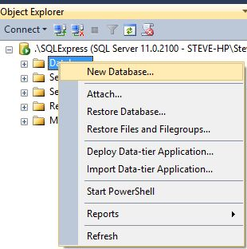
Creating a Database in SQL Server
The easiest way to create a new database is to right click on Databases in the Object Explorer and select “New Database.”

Slide 79
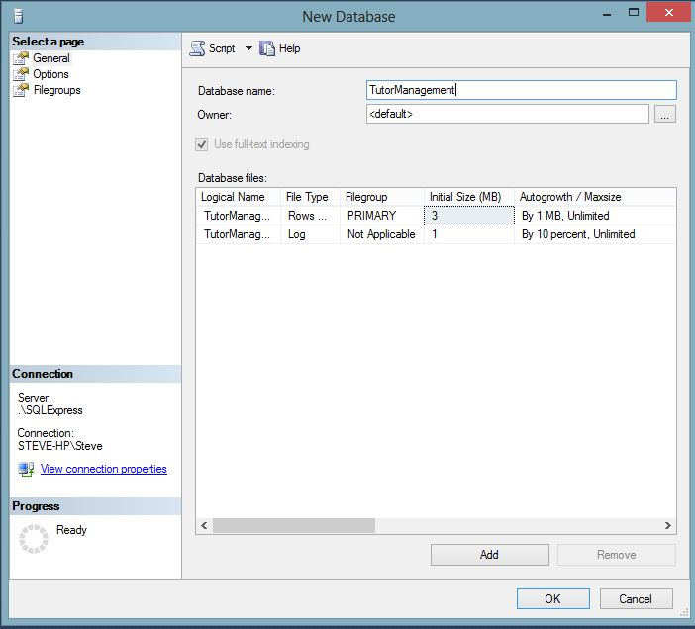
New Database Dialog
Notice that the database has two files: a Primary data file which stores all the data objects and the data, and a log file which logs transactions as they occur.

Slide 80
Data Types
In a Database Table every column must have a data type.
A data type determines what kind of values can be stored in a column.
Numeric data types can store only numbers.
Character data types can store words, numbers, and other characters.
There are several ANSI data types but each DBMS has their own variations and additions.

Slide 81
SQL Server Numeric Data Types
Data Type | Description | Range/Examples
bigint | 8 bytes integer | -2^63 (-9,223,372,036,854,775,808) to 2^63-1 (9,223,372,036,854,775,807)
int | 4 bytes | -2^31 (-2,147,483,648) to 2^31-1 (2,147,483,647)
smallint | 2 bytes | -2^15 (-32,768) to 2^15-1 (32,767)
tinyint | 1 byte | 0 to 255
bit | 1 bit | 0, 1 or Null
decimal | User can set precision up to 10^38 | decimal(10,2)
money | 8 bytes | -922,337,203,685,477.5808 to 922,337,203,685,477.5807
smallmoney | 4 bytes | - 214,748.3648 to 214,748.3647
numeric | User can set precision up to 10^38 | Same as decimal
float | Approximate numeric type, the number of bytes depends on number | - 1.79E+308 to -2.23E-308, 0 and 2.23E-308 to 1.79E+308
real | Also approximate, 4 bytes | - 3.40E + 38 to -1.18E - 38, 0 and 1.18E - 38 to 3.40E + 38

Slide 82
SQL Server Date Time Data Types
Data Type | Description | Examples/Range
date | New in 2008, stores date values | January 1, 1 A.D. through December 31, 9999 A.D.
datetime2 | New: Stores date and time and allows user to set precision in fractions of seconds | Same date range as above. Time range=00:00:00 through 23:59:59.9999999
datetimeoffset | Date and time but with time zone awareness | same
smalldatetime | Smaller date time type | January 1, 1753, through December 31, 9999 00:00:00 through 23:59:59.997
time | New, you can set the precision in fractions of a second | 00:00:00.0000000 through 23:59:59.9999999

Slide 83
SQL Server Character Data Types
Data Type | Description | Examples
char | Fixed length ASCII text | “Jefferson” – max 255 characters
text | Text stores large blocks of text data. The text and ntext data types are deprecated, use varchar(MAX) or nvarchar(MAX) | 2,147,483,647 bytes
varchar | Variable length ASCII | “Los Angeles,” Maximum 255 characters unless MAX (MAX allows 2^31-1 bytes)
nchar | Unicode fixed length | Uses Unicode UCS_2 character set
ntext | Unicode large block. Deprecated
nvarchar | Unicode variable length text

Slide 84
Unicode
Unicode is an extended character set that includes non-Latin character sets such as Russian or Japanese.
It is built into every newer computer.

Slide 85
SQL Server Other Data Types
Data type | Description | Examples
image | Variable length binary data. The image data type is deprecated and will go away. | 2^31-1 bytes
binary | Fixed length binary | 1 to 8000 bytes
varbinary | Variable length binary | 1 to 8000 bytes unless you specify MAX, 2 ^31-1 bytes
uniqueidentifier | Generates a unique identifier | 6F9619FF-8B86-D011-B42D-00C04FC964FF
xml | Stores XML data as XML, can be validated against schema collections, queried with xquery | <employee> <name>Sue Larson</name> </employee>

Slide 86
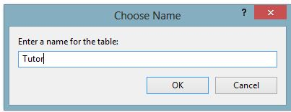
Creating a Table
One way to create a table is:
Right click on the tables folder in the database
Choose new table
Enter the fields and data types
Save and name the table

Slide 87
Nulls
A null is an important concept in databases.
A null represents the absence of a value, an unknown value.
As such it is not equivalent to a 0 or an empty string “”.
Nulls are ignored by most aggregate functions such as count, sum, and average.
You have a choice when designing a table to allow it to accept nulls or not.

Slide 88
Creating a Table with SQL
You can also create a table with SQL:
CREATE TABLE Course
(
CourseKey NCHAR(10) PRIMARY KEY,
CourseName NVARCHAR(50) NOT NULL,
CourseDescription NVARCHAR(200) NULL
)

Slide 89
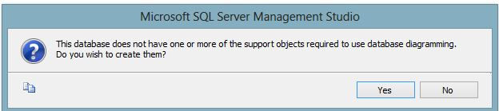
Database Diagram
To create a database diagram, right click on the database diagram folder under the database.
You will receive a message like the following:

Slide 90
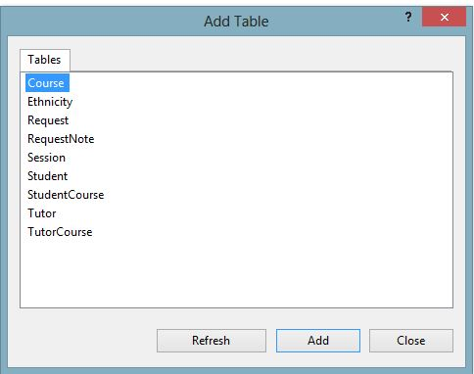
Database Diagram Cont.
Click the yes button. An Add tables Dialog box appears:

Slide 91
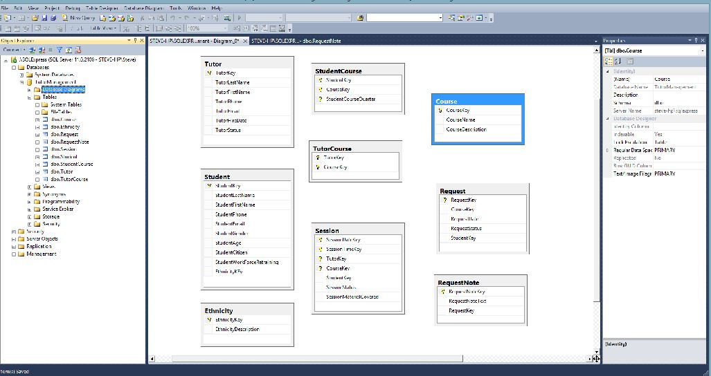
Database Diagram Cont.

Slide 92
Creating Relationships
One way to create relationships in SQL Server is to select a primary key column in the parent table and drag the mouse to the matching field in the child table.
This will bring up the relationship dialog.

Slide 93
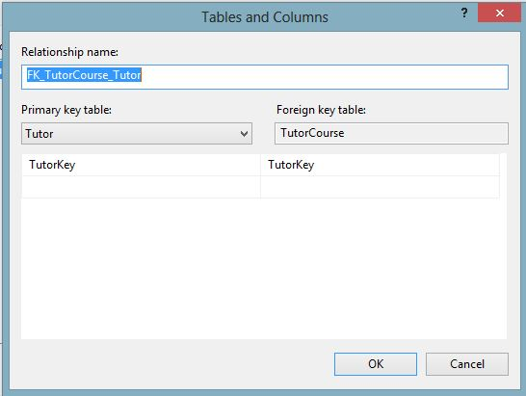
Relationship Dialog
Make sure the tables and columns are correct.

Slide 94
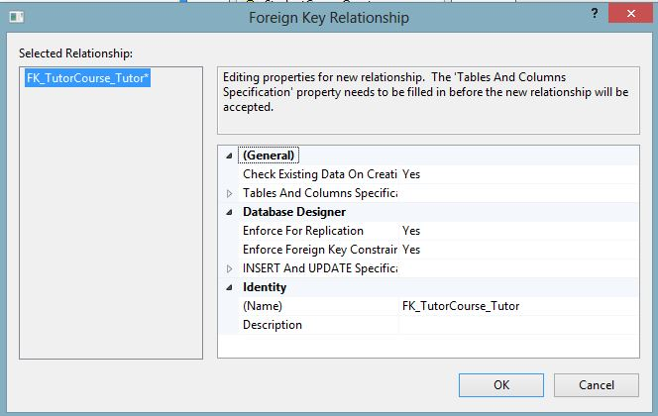
Foreign Key Relationship Dialog
Next you can set properties for the relationship.

Slide 95
Referential Integrity
Referential integrity results from enforcing the foreign key constraint.
Enforcing it means that there can be no foreign key value in the child table that does not exist as a primary key value in the parent table.
Enforcing referential integrity prevents orphan records, for instance, an order that has no customer making the order.

Slide 96
Effects of Enforcing Referential Integrity
Action | Effect of Enforcing Referential Integrity
INSERT | You must enter data into the parent (primary key) table before you can enter data into a child (foreign key) table. Example: You must enter the customer information before entering the sale information.
UPDATE | You cannot change the primary key value for any record in the parent table without also changing the related foreign key. This creates a dilemma because both must be changed simultaneously. You can either suspend referential integrity while making the update or use Cascading Updates (see below). You can only update or change a foreign key in a child table to one that has a matching value in a parent or primary key table.
DELETE | You cannot delete a row in a primary key table unless all related records are first deleted in the foreign key table. Example: you can’t delete an order unless all the order details for that order are first deleted.

Slide 97
Sample Data
Once the tables are complete, it is a good idea to enter some sample data in order to test the database.
Make sure your sample data (are):
Complete enough to test the data
Varied enough to represent a variety of likely scenarios
Contain some exceptions and perhaps even some errors in order to test how your database handles them

Slide 98
Documentation
In many ways the database is self documenting.
System tables keep the “meta” information tables and other objects.
But it is useful to keep a separate data dictionary that describes all tables, columns, data types, and constraints.

Slide 99

All rights reserved. No part of this publication may be reproduced, stored in a retrieval system, or transmitted, in any form or by any means, electronic, mechanical, photocopying, recording, or otherwise, without the prior written permission of the publisher. Printed in the United States of America.

